Slide 1

Microsoft Office
PowerPoint Basics

Slide 2
What is PowerPoint?
Notes:
PowerPoint is part of the Microsoft Office suite. It is a powerful tool used to create presentations. It provides everything you need to create a professional presentation. PowerPoint contains graphic tools and word processing tools and is easy to use. PowerPoint are created from a series of slides. PowerPoint can be referred to a slideshow presentation.

Slide 3
How is PowerPoint used?
Notes:
PowerPoint is used by students, teachers, companies, and for fun. Teacher use PowerPoint for their instruction to show how to complete a task. Students use PowerPoint to present their assignments to classes. Companies use PowerPoint to instruct staff on policies or to discuss budgets. Users have used PowerPoint to display family photos at weddings or funerals. PowerPoint presentations are usually displayed on a screen behind a speaker. PowerPoint presentations usually contain a large amount of images with little text. Meant to grab the audiences’ attention.

Slide 4
Benefits of PowerPoint
Notes:
Easy to learn and fun to use. Contains multiple features. Easy to make personal and unique presentations. Easy to save and share. Contains themes and color layout so even the non-designer can make a visually-pleasing presentation. CONS: need to purchase MS Office Suite

Slide 5
What makes a good presentation?
Notes:
Ask: What makes a good presentation?

Slide 6
Pleasing Design
Engaging Content
Notes:
Presentations should have a pleasing design. It should contain useful information and contain images and attractive font with engaging content.

Slide 7
Would you rather view…
Notes:
Would you rather look at…

Slide 8
Moses is a guinea pig
Moses likes hanging with his friends
Moses likes vegetables
Notes:
This information is okay. Easy to read...

Slide 9
Or would you rather view …
Notes:
Would you rather look at

Slide 10
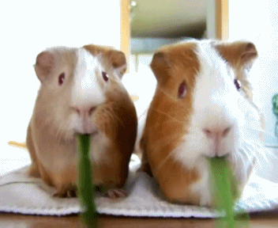
Moses!
Notes:
Basically, the moving images provide a visual of “Moses is a guinea pig, Moses likes hanging with his friends, and Moses likes vegetables.” PowerPoint makes it simple to add videos and gifs to your presentation.

Slide 11
Is this easy to read?
Guinea pigs benefit from feeding on fresh grass hay, such as timothy hay, in addition to food pellets which are often based from timothy. Alfalfa is also a popular food choice; most guinea pigs will eat large amounts of alfalfa when offered it, though some controversy exists over the feeding of alfalfa to adult guinea pigs. Some pet owners and veterinary organizations have advised that, as a legume rather than a grass hay, alfalfa consumed in large amounts may lead to obesity, as well as bladder stones due to excess calcium, in any but pregnant and very young guinea pigs.
Notes:
Is this easy to read? Not really. Too much text describing what a guinea pig will eat.

Slide 12
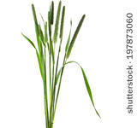
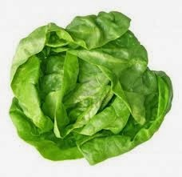
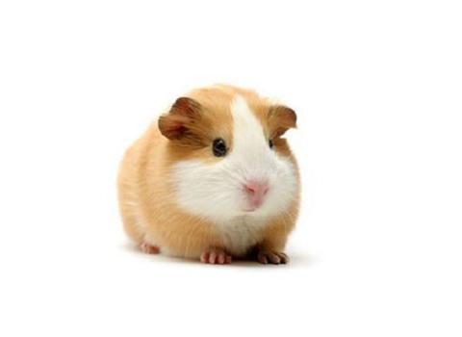
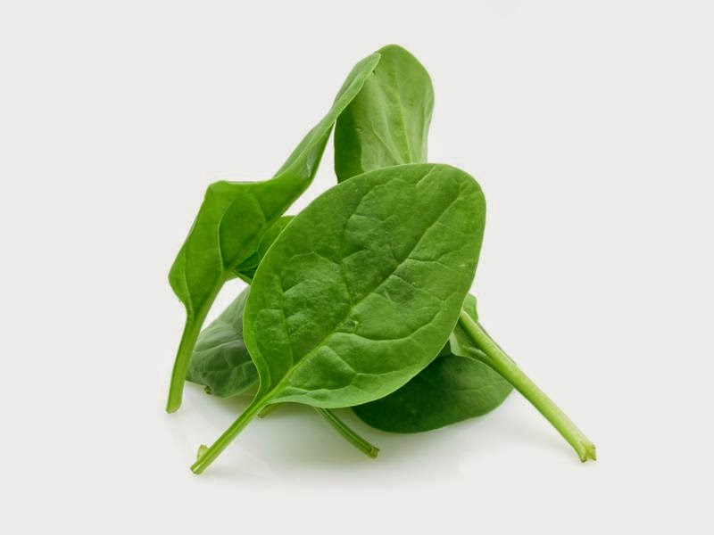
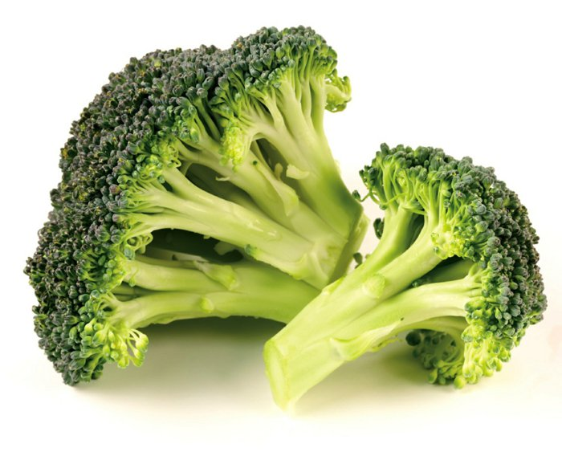
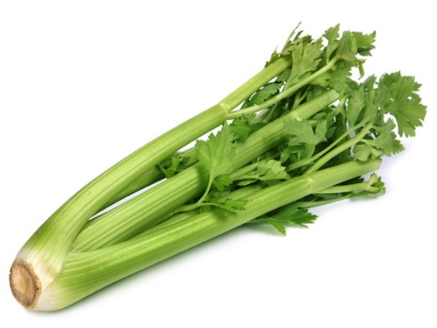
Keep a Simple Design!
Notes:
This is a great way to use visuals to describe what a guinea pig eats. This is much more engaging than reading the long text description. PowerPoint makes it simple to add images to enhance your message.

Slide 13
Use animations!
Notes:
Using animations can make your presentation even more engaging. PowerPoint will allow you to create animations. Images and text can fly in different directions and styles!

Slide 14
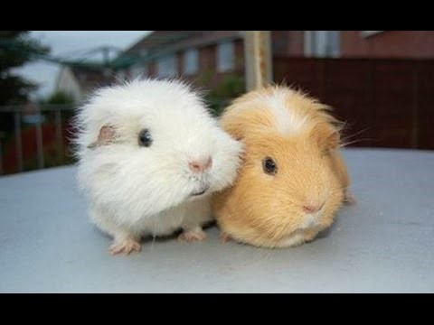
Add Media!
YouTube Videos
Photographs
Sound effects
Notes:
You can embed videos directly into PowerPoint. You can also add images, photographs, and sound effects.

Slide 15
Common PowerPoint Mistakes…
Notes:
Here is some common PowerPoint mistakes that presenters have done.

Slide 16
Too Wordy
Hay, vegetables, fruits, branches, herbs and other plant. Guinea Pigs have a big and variety menu table. They are oriented by their natural instinct and really like to eat what grows on ground – raw. Most of all feed hay! This has to be provided permanent. You do your best to your cavies if you provide fresh picked grass too (please no lawn cuttings!). That is way cheaper than any colorful package of junk food from the pet shop and much more healthy as well. Leave the pet shop food untouched (have a look to thedry food / pellets article)!
Notes:
Too many words! Your presentation is meant to keep you on task and aid you during your presentation. You do not want to have your audience reading this while you are presenting. They will be too busy reading to listen to your message. PowerPoint should only contain short statements to enhance your message.

Slide 17
Spelling Errors
Hay is an important part of a ginee pig's diet.
Difrent varieties provide different texture and fiber content.
Notes:
Spelling errors can be embarrassing. Be certain to check for spelling and data errors before presenting. Errors will leave behind a bad impression and weaken your presentation.

Slide 18
Too Many Bullet Points
Alfalfa, radish & clover sprout
Basil
Beet Greens (tops)*
Brussel Sprouts
Carrots
Carrot Tops*
Chard (red or green)*
Cilantro
Clover
Cucumber
Dandelion Greens (no pesticides)*
Escarole
Green Peppers
Mint
Parsley*
Pea Pods (the flat edible kind)*
Peppermint Leaves
Radichio
Radish Tops
Raspberry Leaves
Romaine Lettuce or Red/Green Leaf Lettuce
Watercress*
Wheat Grass
Notes:
It is not recommended to have too many bullet points. You would be better off choosing a few and adding images. If you find you need to provide a list of items, you may wish to consider creating a handout or brochure.

Slide 19

Unappealing Colors
Notes:
PowerPoint makes it easy to create attractive presentations using theme settings. Themes will provide attractive background colors with complementing font colors. You do not need to be a graphic designer to create attractive presentations.

Slide 20
Let’s Learn PowerPoint!
Notes:
Let’s Learn PowerPoint!

