Slide 1
Birds

Slide 2
Blue Bird

Slide 3
Red Bird

Slide 5
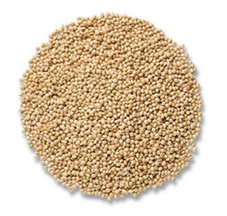
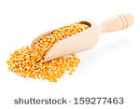
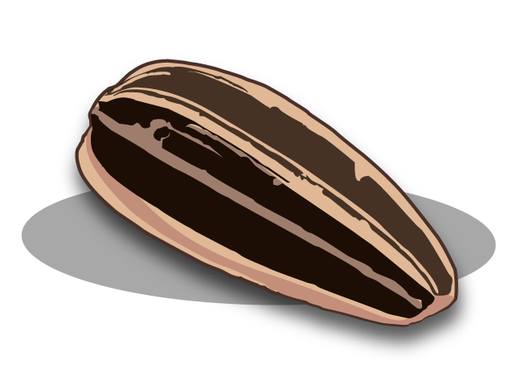
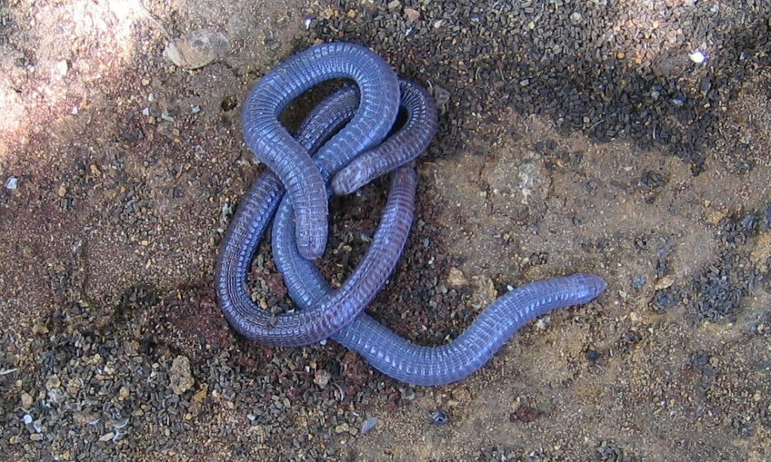
Bird Food

Slide 6
Video about Birds

